Slide 1
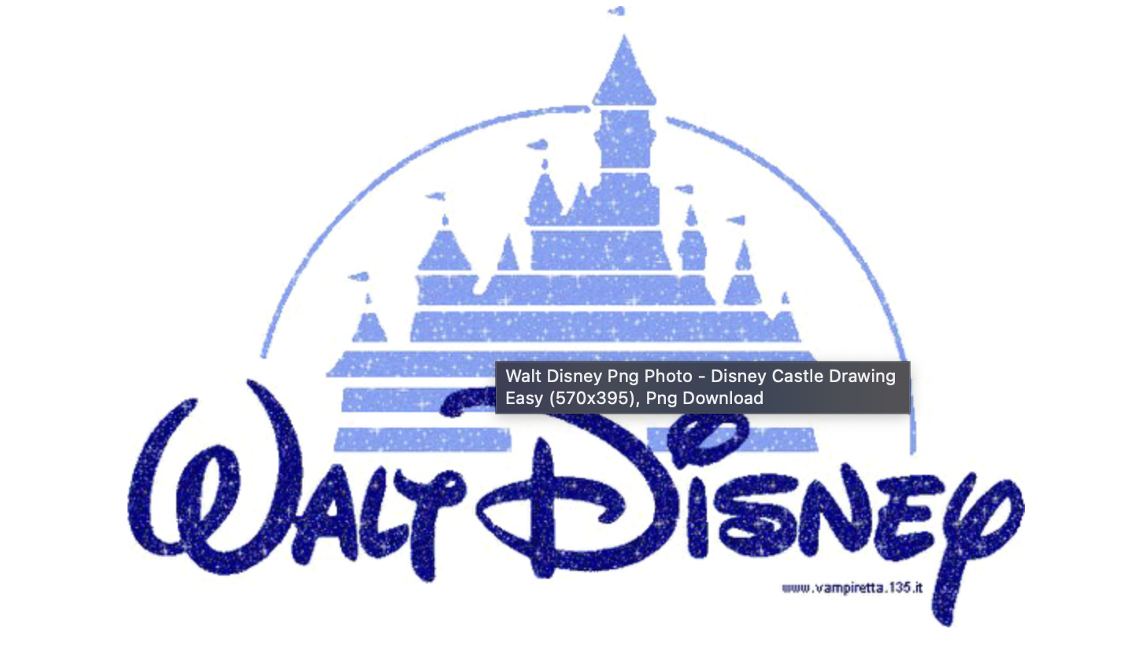
Can Disney Movie Contents Compete with Netflix?
A comparative study

Slide 2
Contents
Background
Research Question
Comparison of the contents
Disney’s Growth strategy based on it’s competitive edge
Further discussions

Slide 3
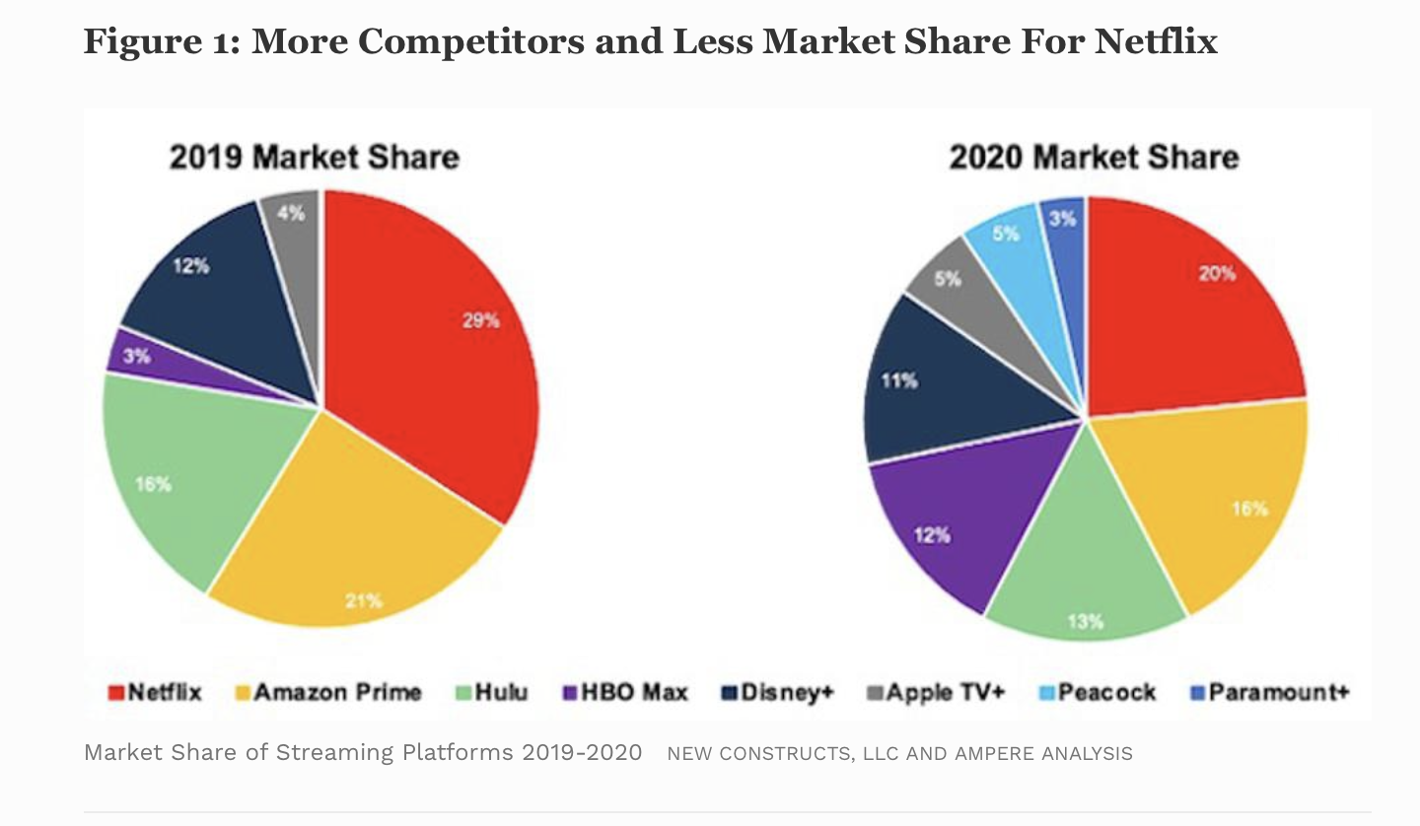
Background
Disney entered the streaming market in October 2019.
With a vast number of original productions, how does Disney Plus’ content compare with NetFlix?
Picture comes from Forbes.com, May 10, 2021,09: Netflix: a Meme – Stock Original by David Trainer of Great Spectation Groups

Slide 4
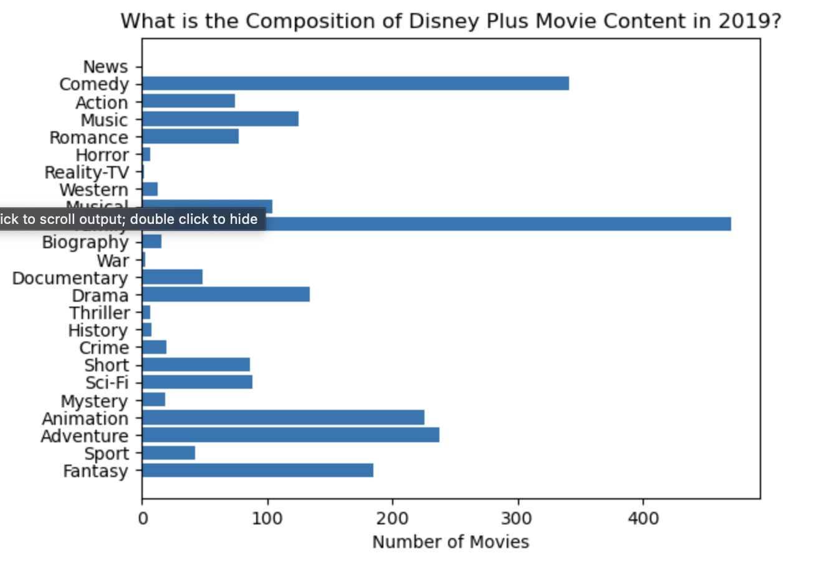
Research Question
How do the movies in Disney movies perform in terms of ratings as compared with Netflix’ movies of the same genres?
How should Disney Plus’ form its strategy going forward to maintain it’s competitive edge?

Slide 5
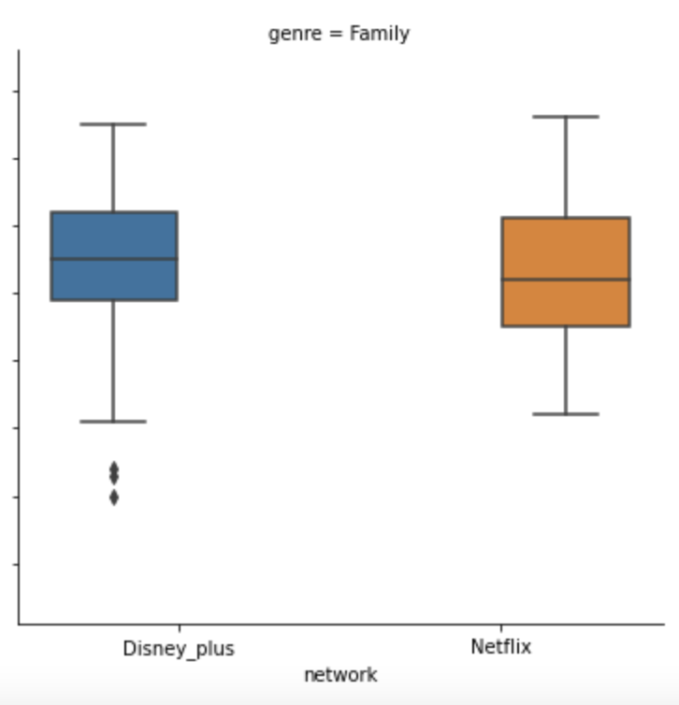
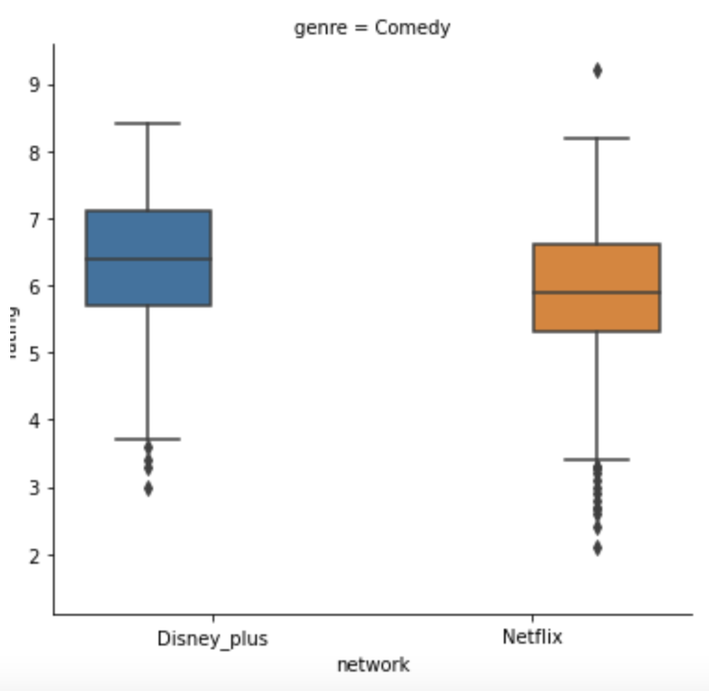
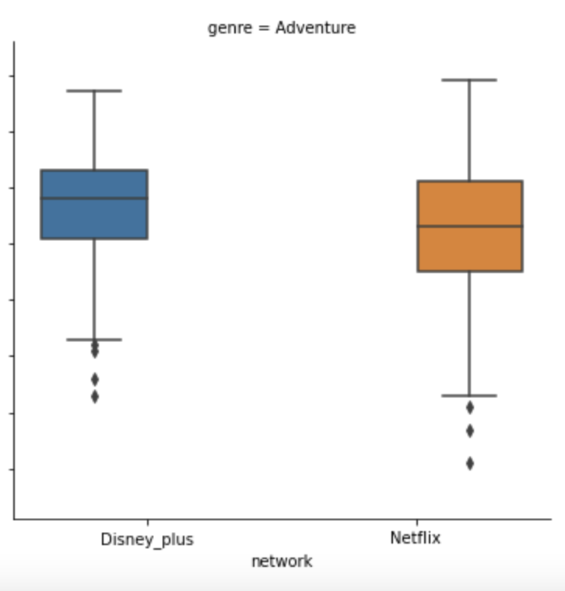
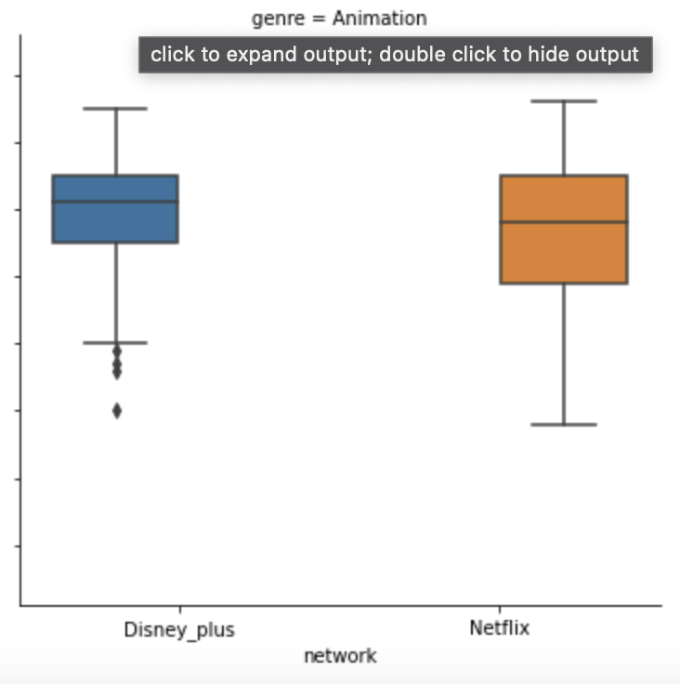
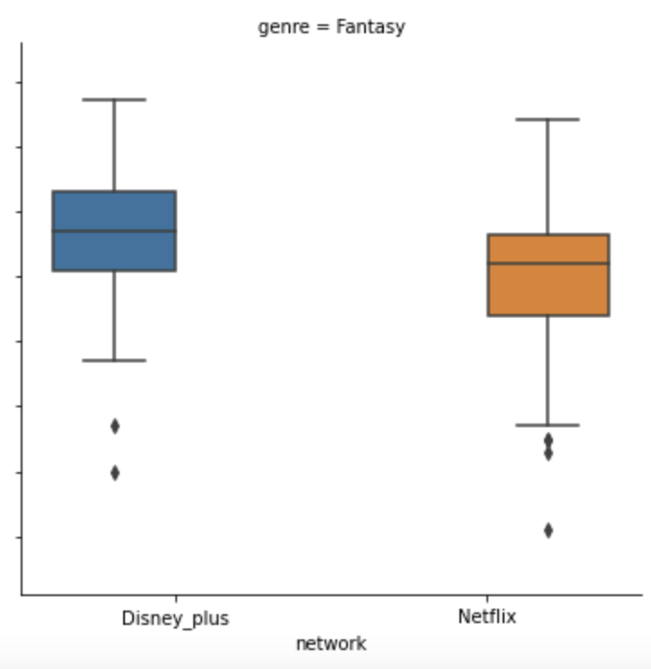
Ratings of the top 5 genres with the most movies, compared with Netflix: Families, Comedies, Adventures, Animations and Fantasies

Slide 6
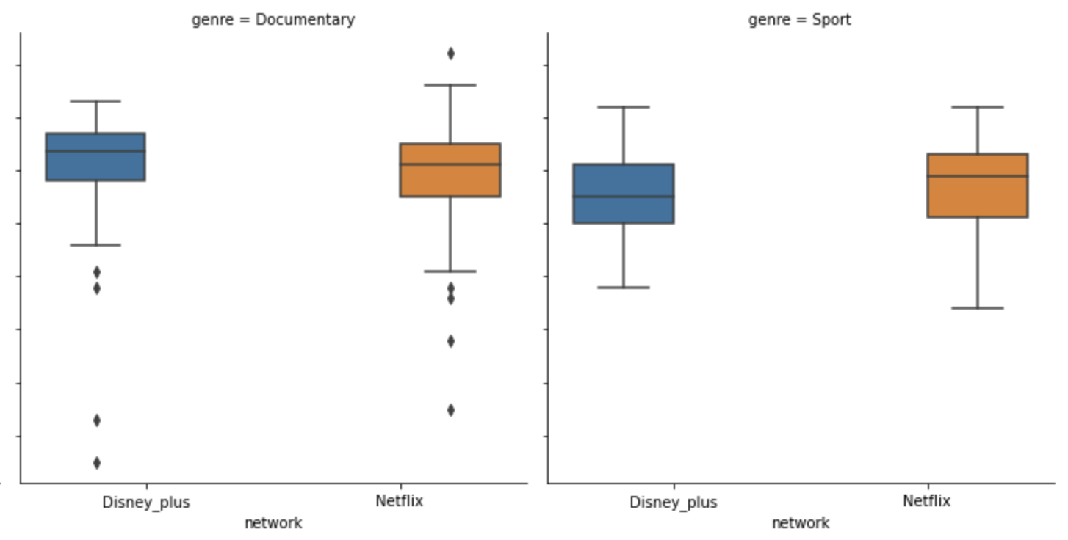
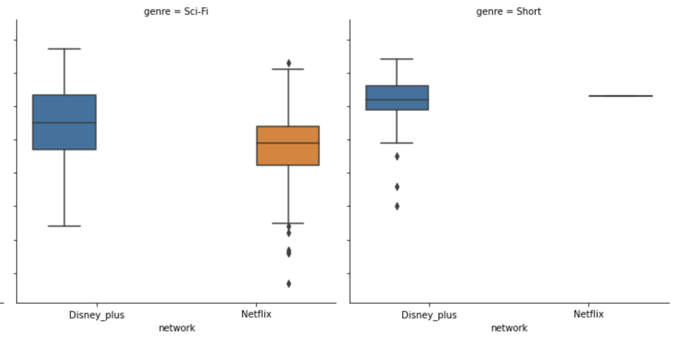
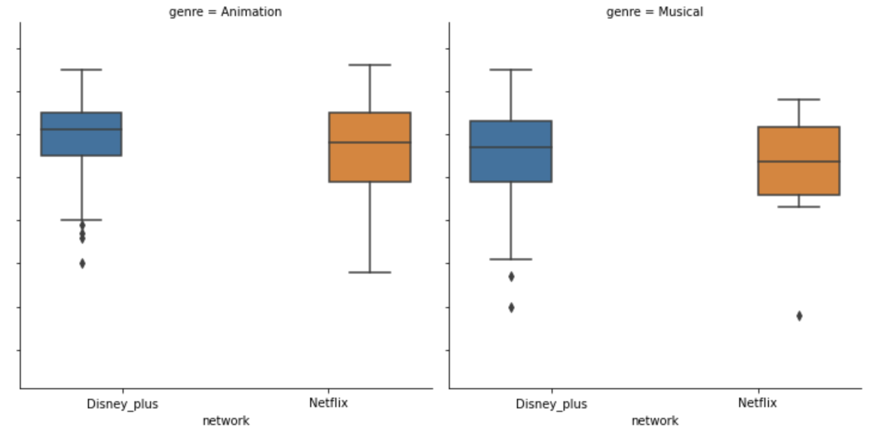
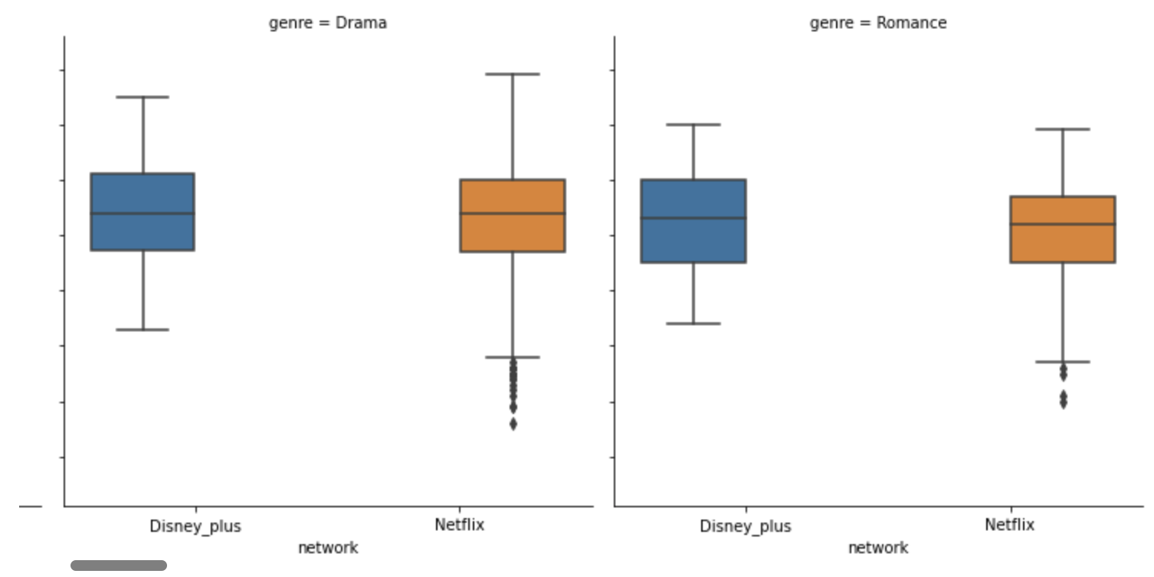
What about other genres?

Slide 7
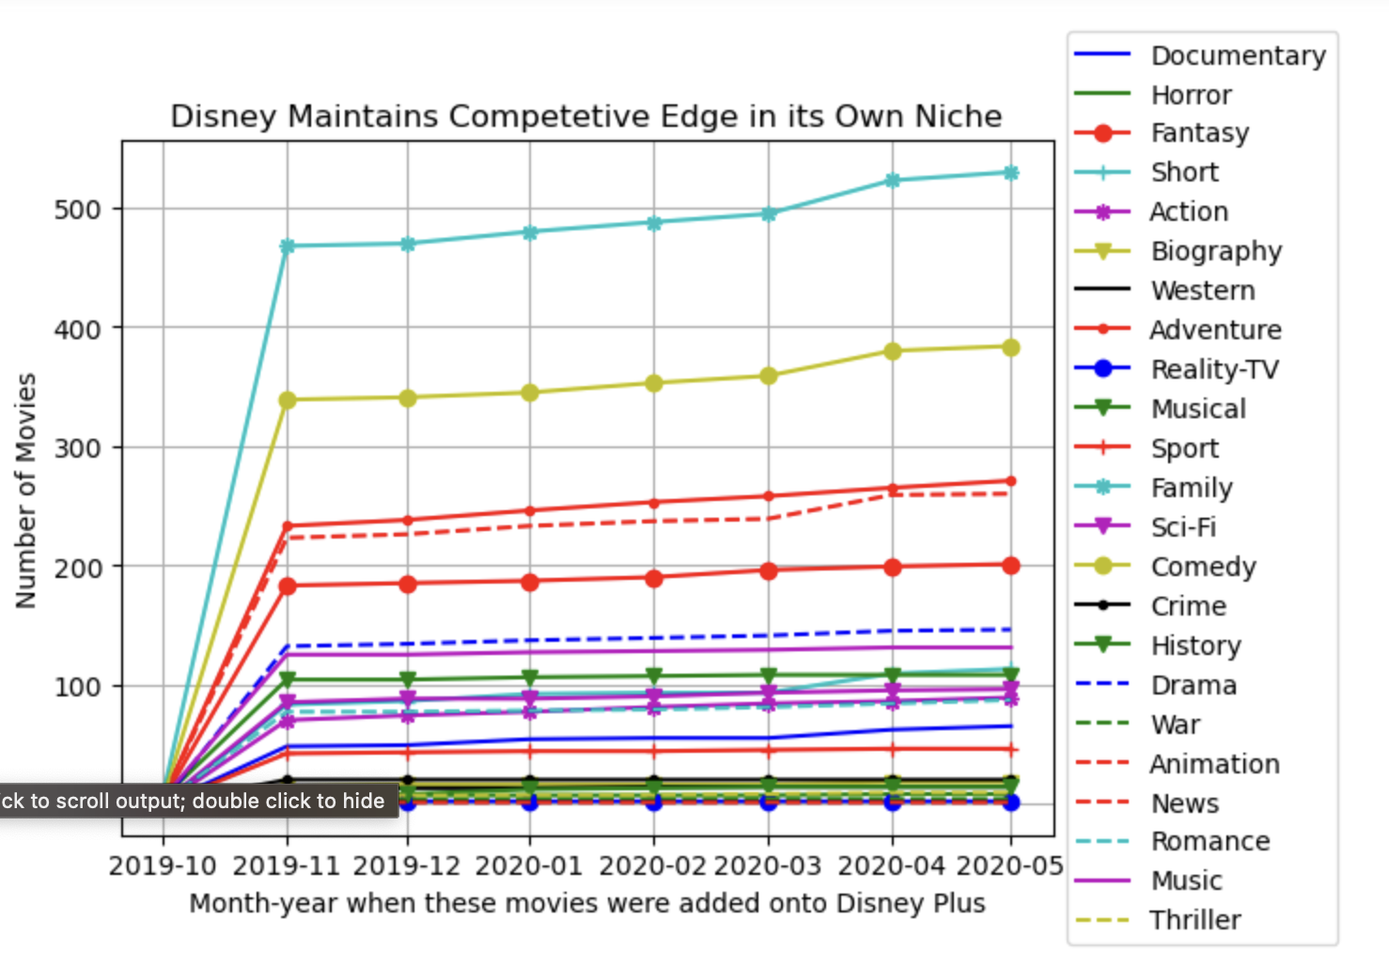
How did Disney Plus grow its movie contents since its launch?

Slide 8
Net Steps
Integrate other metrics to evaluate the health of the network:
Average length of TV series?
Growth of Subscription numbers
length of TV runtime analysis of the two networks.
A deeper dive into subtypes of products provided:
Movies → TV movies
TV shows → mini series

Slide 9
Appendix
Kaggle Datasets:
Disney Plus Movie and TV shows by Raphael Fontes
Netflix Movie and TV shows by Snehaan Bhawal

